Slide 1
Grocery Store Optimization
Team 6 Vatsal Jigar Kadakia(vkadakia@stevens.edu)
Kislay Kislay(kkislay@stevens.edu) Mohammed Salman Taqi(m4@stevens.edu)

Slide 2
Introduction
Enhance businesses with ML algorithms
Chose grocery store dataset
Developed hypothetical client called “ABC Grocery Store”
Implemented Supervised and Unsupervised ML algorithms
Used 10 algorithms
Compared and displayed results using python libraries
Learnt how to apply learning on real time dataset

Slide 3
ML algorithms
Linear Regression
Decision Tree Regression
Random Forest Regression
Logistic Regression
Decision Tree Classification
Random Forest Classification
KNN Classification
K means Cluster
Principal Component Analysis
Association Rule Learning

Slide 4
Linear Regression
Problem Statement:
Earlier this year, “ABC Grocery” employed a consulting company to provide them “loyalty scores” for their customers. Loyalty score measures the percentage of grocery spend that a customer allocates to “ABC Grocery” vs their competitors. Unfortunately, the consulting company was only able to match around half of the customers to their loyalty database, the other half is missing. Our regression task is to find a way to predict the missing loyalty scores. That would add huge value to their business as it would enable them to target all customers with specific offers and discounts based on their loyalty to ABC Grocery.
To determine factors behind the missing loyalty scores of customers, we used Linear Regression as the first case. In Linear regression, it is very important to deal with the outliers, then split input and output variables. Another important factor is to drop the categorical variables and assign them binary values. Next we selected the feature. We used Recursive Feature Elimination with Cross-validation also known as RFECV from scikit library.

Slide 5
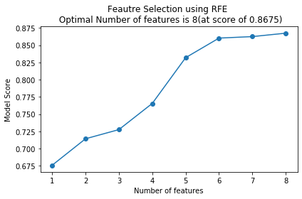
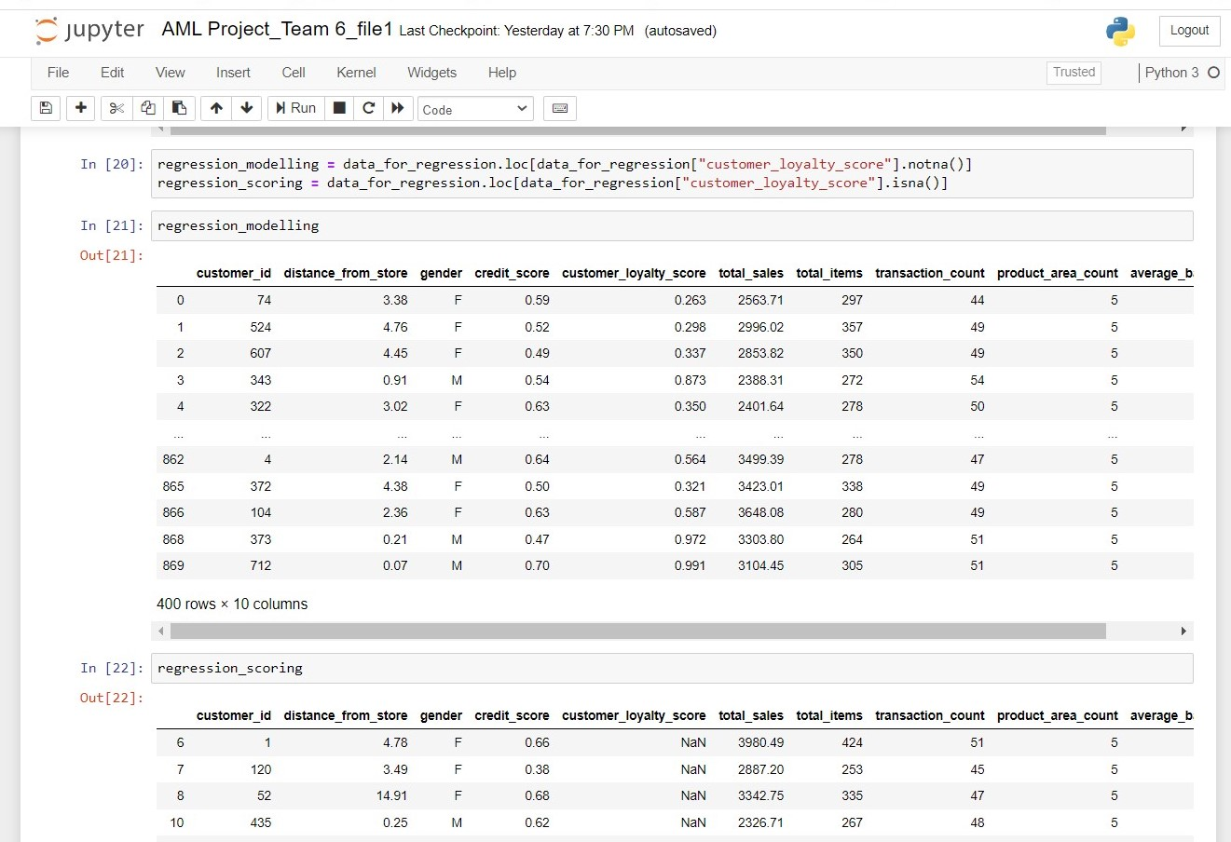
Linear regression graph below indicated the number of optimal features is 8 at the maximum score of fit.grade_scores 0.8675. Model training is done on train set and model assessment is done on test set. Test size is 20\%. After calculating r-squared score(78 %) and cv score(85%) we extract the model coefficients and get to know that the distance from the grocery store to customer's house was the most affected factor in determining the loyalty score. As we can observe from the table of coefficients, distance from the store has the most negative coefficient meaning the customers are less likely to come to ABC grocery if the distance is too far away from their houses.

Slide 6
Decision Tree Regression
Next, we carried out the same process for Decision Tree Regression but with additional features.A Decision Tree is a model that splits the data into distinct buckets using input variables, with split decisions being based on how well each potential split explains differences in the output variable.
Over fitting is the most common error cause in Decision Trees. We demonstrated and took care of over fitting by calculating the maximum depth of the list of features to get an approximation of the accuracy of our model and compare it with model of Linear Regression

Slide 7
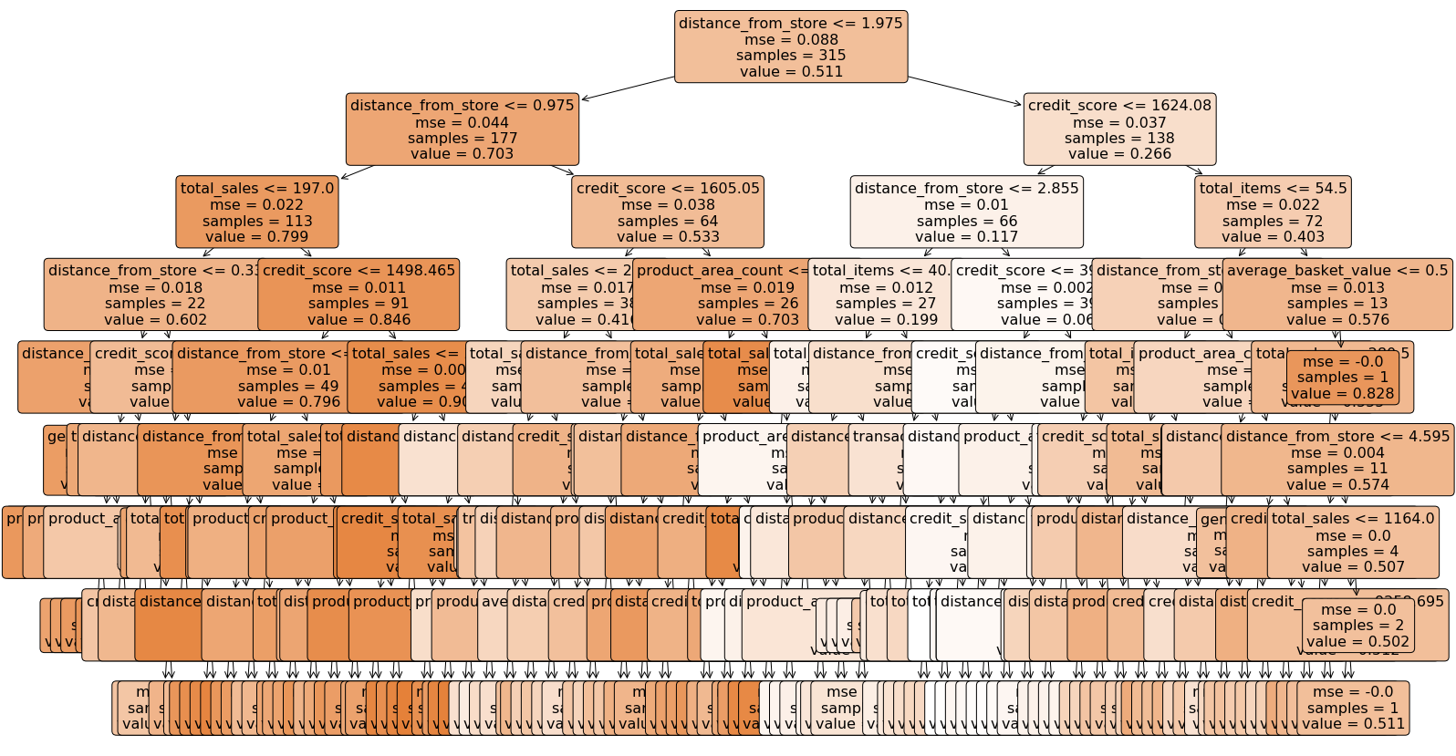
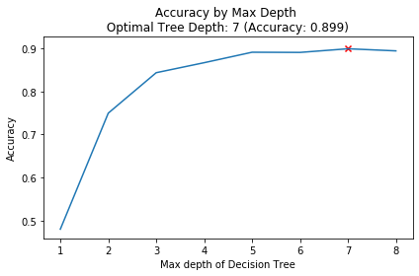
The implementation graphs for decision trees are displayed below. They also indicate the same that distance_from_store is the most affecting factor. Demonstration of over fitting is done using regressor.predict(X_train). Then the best maximum depth for the optimal tree is calculated and decision tree is plotted. The maximum depth of the tree(also the optimal depth) turned out to be 7 with root node as distance from the store. Before dealing with over fitting, r-squared score was approximately 86\% and after adjusting the over fitting it improved to around 90%. Overall, the accuracy of the model was almost 90%. Cross validation score was 80% with k=4 splits.

Slide 8
Random Forest Regression
Lastly for the final comparison in regression, we implemented the same model using Random Forest algorithm. A Random Forest is an ensemble model consisting of many Decision Trees working together across different randomly selected subsets of the data, facilitating improved accuracy and stability.
In RF, feature\_importance and permutation\_importance are displayed and calculated using the trained and tested data.

Slide 9
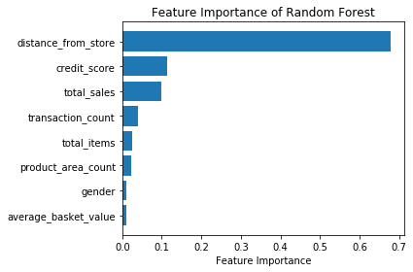
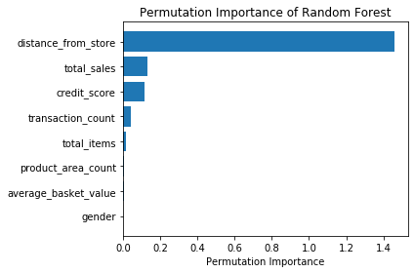
In Random Forest Regression, the bar graphs of selected features and permutation confirm our result that distance from the grocery store matters a lot to maintain loyalty of customers. Distance from the store has the highest feature importance of 0.7 and permutation importance of 1.4. Other variables have significantly low importance in the decision trees. In regression, this was by far the best performing algorithm compared to linear and decision tree with a r-squared score of 96\%, cross validation score of 92%, adjusted r-squared score of approximately 95%. An array of predictions was displayed in the code for all the decision trees.

Slide 10
Logistic Regression- Classification
Logistic Regression is a model used to predict the probability of a certain event or class based one or more input variables. It transforms linear relationships to a probabilistic output through the Logistic Function.
transforms linear relationships to a probabilistic output through the Logistic Function. Although it is a regression model, it is widely used for classification problem. The probability for the customer signup rate is calculated for the delivery club campaign.

Slide 11
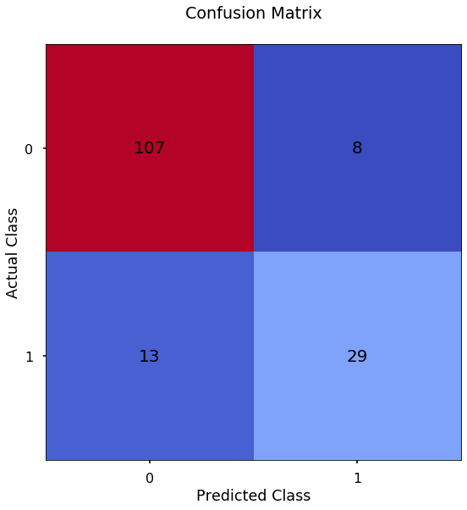
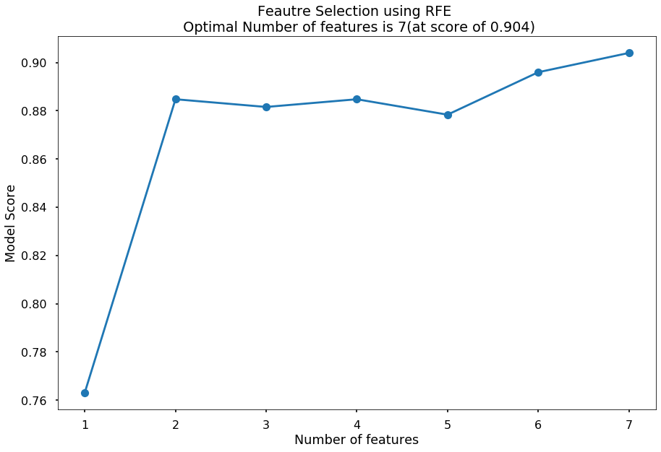
From the confusion matrix, we can observe that 107 are True Positive values meaning most of our prediction was correct compared to the True Negative and False Positive values of 29 and 13 respectively. Accuracy score(number of correct classification out of all attempted classifications) is 86%. Precision score(of all observations that were predicted as positive, how many are actually positive) of 78%. Recall score(of all positive observations how many did we predict as positive) of 69% and f1 score (the harmonic mean of precision and recall) of 73%. Optimal number of features is 7 with an optimal threshold of 0.44.

Slide 12
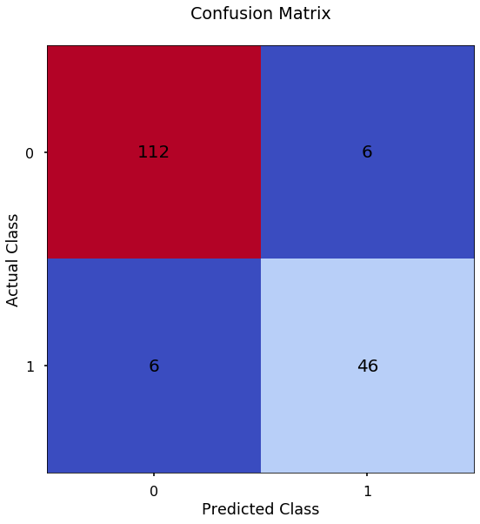
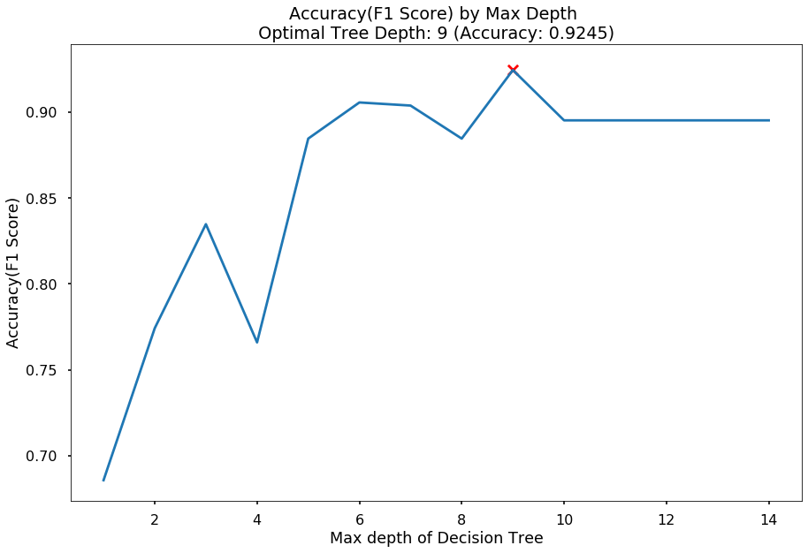
Decision Tree - Classification
In Decision Tree Classification, optimal depth of the tree is 9. In regression it was 7. Hence, this tree classifies more leaf nodes. Maximum model accuracy is 92%. Precision score of 88\%, Recall score of 88% as well and f1 score of 88% as well. There are 112 True Positive values and 46 True negative values indicating that the model can be much better. But its a little better than Logistic regression classification.

Slide 13
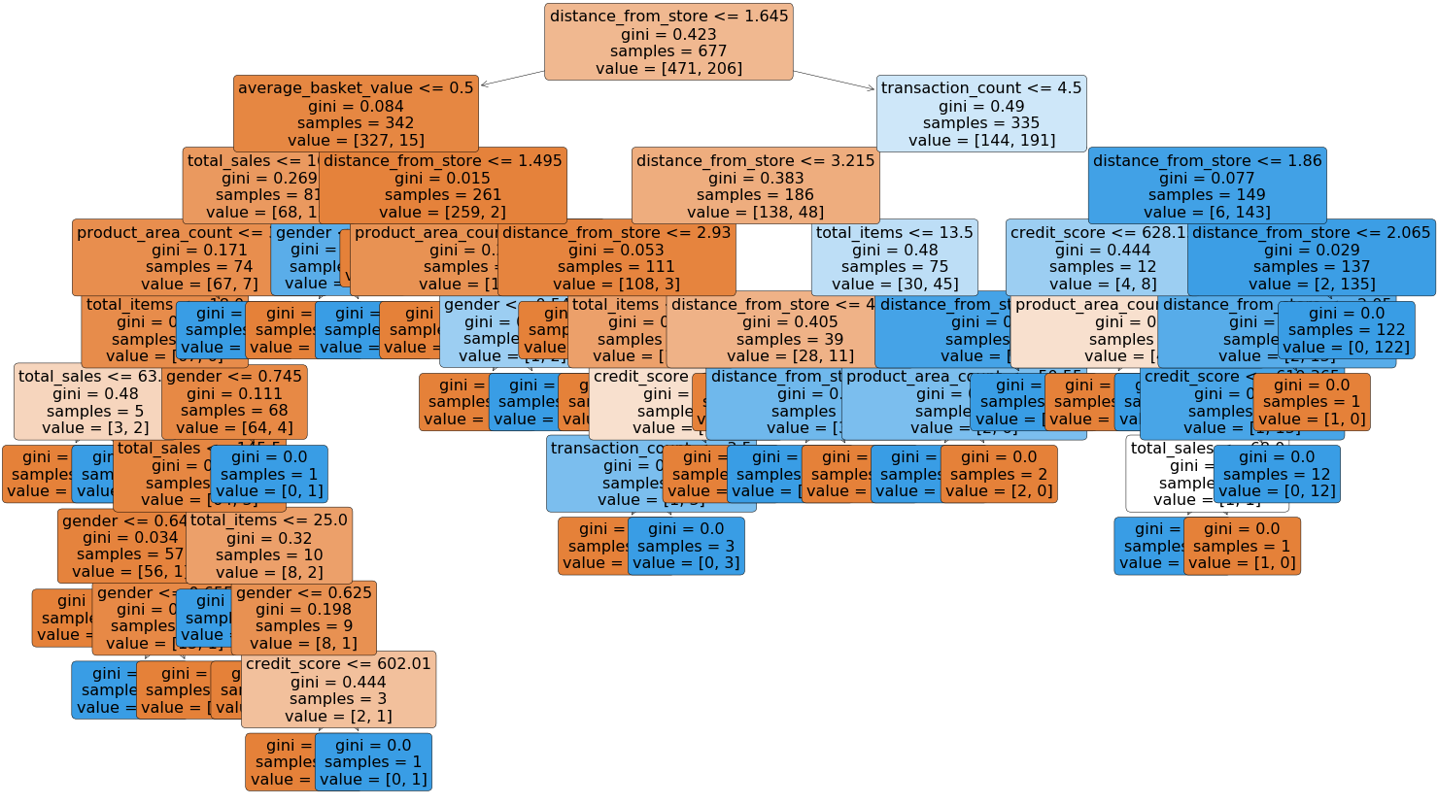
Decision Tree - Classification

Slide 14

Random Forest Classification
For the Classification task, to find the probability of customers signing up for the delivery club we used all the classification algorithms(Decision Tree, RF, Logistic, KNN) to determine the difference in the confusion matrices, f1 score, precision and recall scores. These all parameters decide why and what type of customers decide whether to signup for delivery club or not.

Slide 15
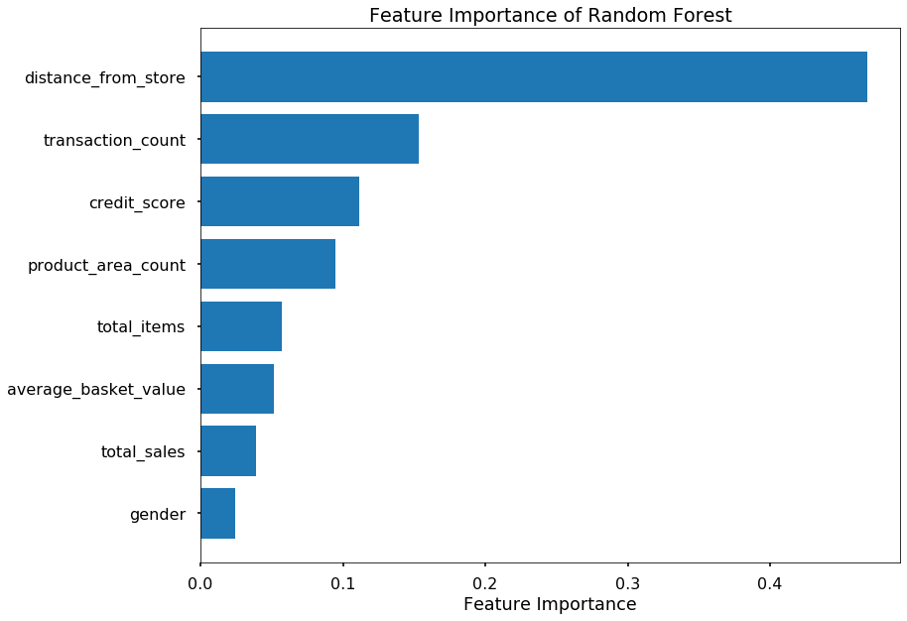
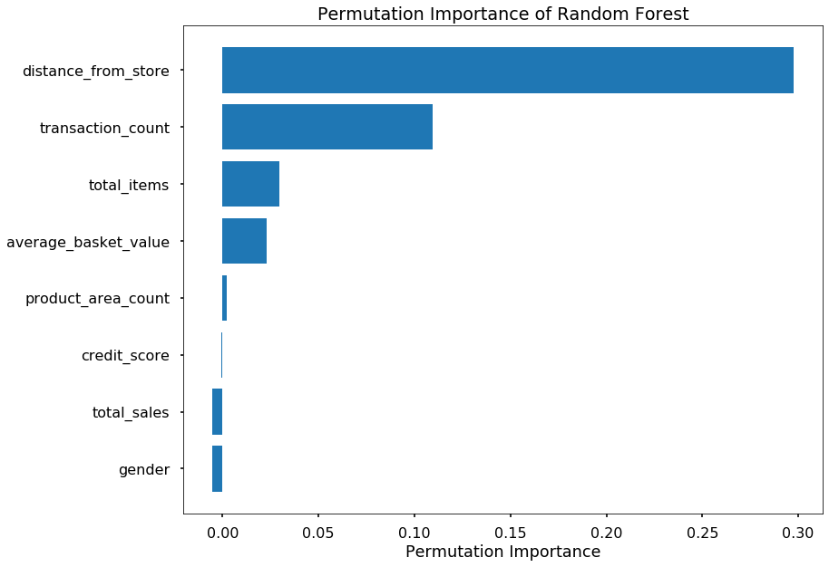
In Random Forest classification, model accuracy is 93%. Precision score is 88%. Recall score is 90% and f1 score is 89%. The confusion matrix is almost similar to Decision tree classifier, just one less False Positive value which lead to a better model than decision tree. So in both cases, Random Forest turned out to be the best algorithm for this particular grocery dataset.

Slide 16
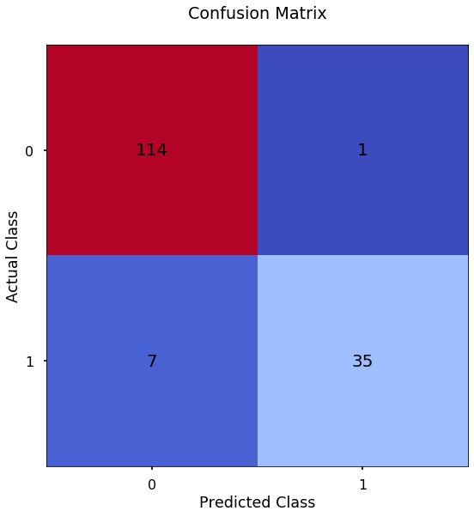
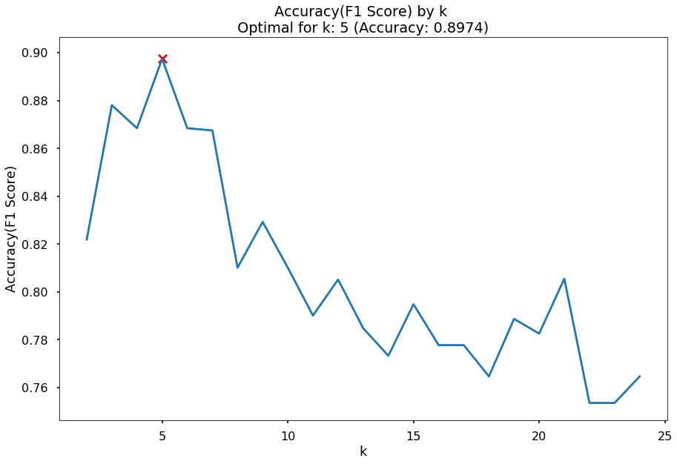
KNN Classification
The KNN algorithm predicts a class for an unknown data point using the most popular class of a number of nearby known data points. The number of nearby data points used to form a prediction is denoted by k. The feature selection in this case is Random Forest classifier. Model accuracy is 95%. Precision score of 97%. Recall score of 83% and f1 score of 89%.. Optimal value for k obtained was 5. The confusion matrix is comparatively much better with 114 True Positive values.

Slide 17
K means Clustering
For the next task, K-means Clustering is used as we can clearly observe the cluster of customers by aggregating the data and then dropping the non-food category. The algorithm created four clusters - Dairy, Fruit, Meat and Vegetables and distributed the customers in respective clusters based on their customer\_id, transaction summaries, sales of each category and product areas.

Slide 18
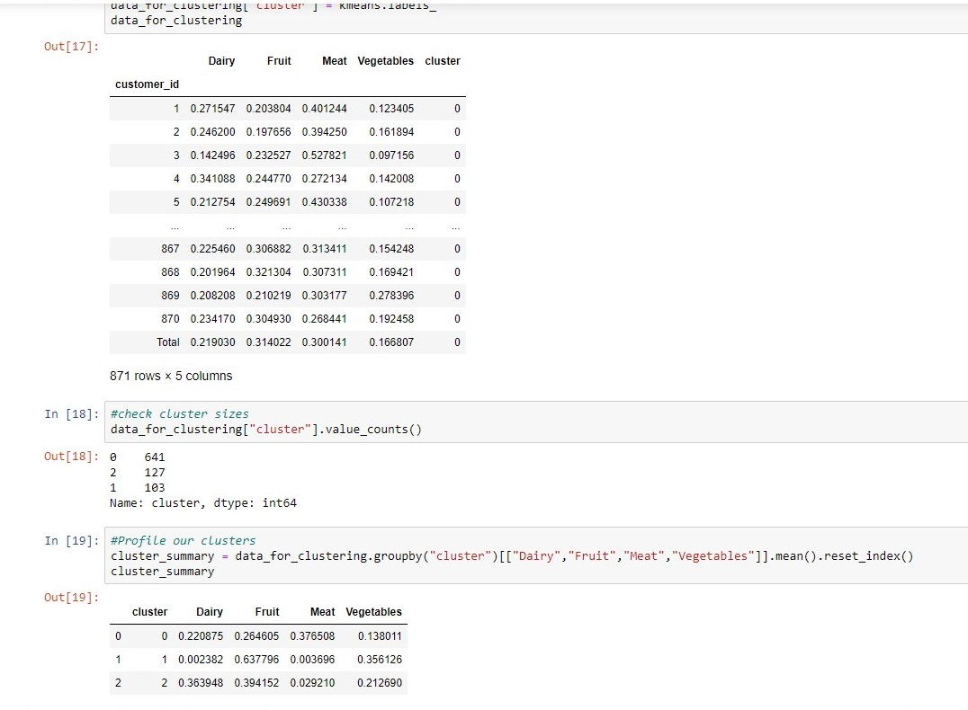
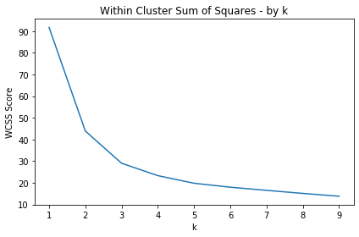
K means Clustering partitions data points into distinct groups based on similarity with each other. the number of distinct groups is determined by k. Here sales are aggregated at customer level by product area to accurately predict which customer falls into which category. Since Food category is highly relevant than non-food category in this dataset to determine the sales and purchasing habits of customers, non food category is dropped. 3 distinct clusters are created in a dataframe as displayed below in the figure. Data is normalized using MinMaxScaler method

Slide 19
Principal Component Analysis
PCA is often used as a Dimensionality Reduction technique that can reduce a large set of variables down to a smaller set that still contains most of the original information. We blend the original features/ variables and create components which has the key information of the dataset.
For this, just like k-means we have to manually input how many number of principal components we want. Before applying PCA, it is important to to always apply scaling to your variables. We used standardisation instead of normalisation. It is bound to lose some of the information/variance contained in original data

Slide 20
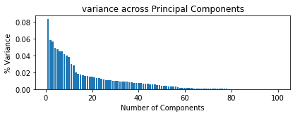
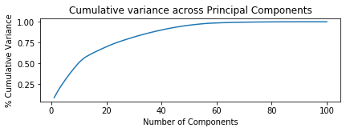
In Principal Component Analysis, StandardScaler method is used to scale the data into components. First the variance of each component is displayed and then the cumulative variance graph is plotted. 0.75% cumulative variance is obtained and with the help of that we can observe that 100 different artists are divided into 20-25 components. Hence the data is scaled down by including all the artists to determine the listening habits of customers and decide whether they will purchase the new album of Ed Sheeran or not. Model accuracy is calculated taking Random Forest classifier since it was the best performing algorithm in our case. 92% accuracy was achieved which is very good.

Slide 21
Association Rule Learning
Association Rule Learning is an approach that discovers the strength of relationships between different data points.
It is commonly utilised to understand which products are frequently purchased together. In this task, we had to find what brands of alcohols were purchased together. For example, French wines - red and white were frequently purchased together. From this we can hypothesize the purchasing habits from the transactions.
Apriori algorithm is used for this which is the most part of this task.

Slide 22
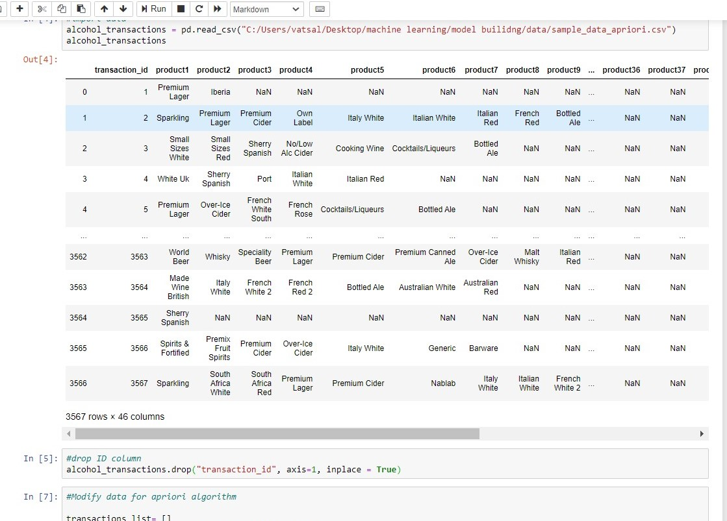
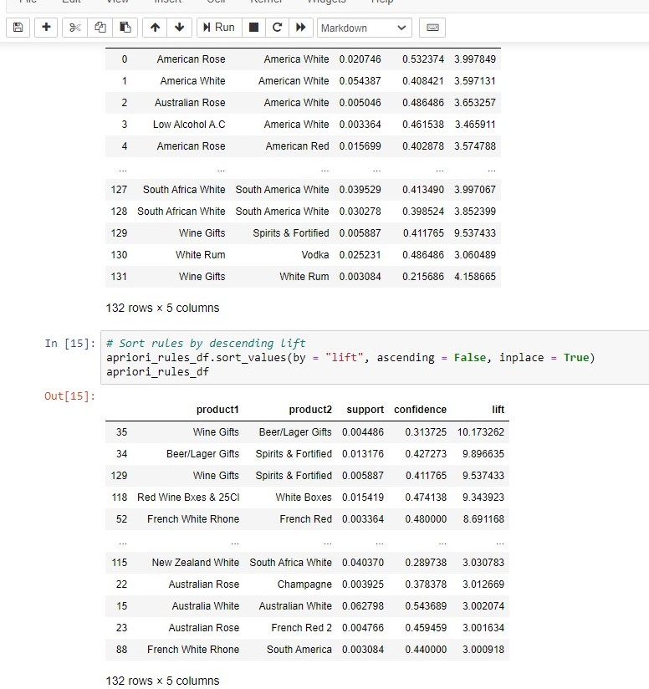
In Association Rule Learning, missing values of all the 3,500 alcohol transactions are first dropped. Then using apriori algorithm, support, confidence and lift values are calculated and displayed. The combinations of various alcohol brands are displayed. For example, we can observe that Wine Gifts and Beer gifts are most frequently purchased together as a combination. So the customer either buys wine gifts or beer gifts and they should be arranged together for the better comfort of customers.

Slide 23
Our learnings
For 1st task in predicting the loyalty score and determining it's factors, Random Forest Regression was the best algorithm as it predicted the best r2 score, cv score and adjusted r2 score. Its bar graphs also demonstrated very clearly and precise that distance from the store was the main factor.
All of the regression and classification algorithms determined distance from store was the most affecting factor in customer loyalty scores, but overall the best models were of Random Forest regression and Random Forest Classifier.
The initial process of dropping missing values, joining the tables and aggregating and then dropping the categorical variable using OneHotEncoder which is 'gender' in this dataset, split the data into training and testing is the same for all algorithms.
Then the later feature selection differs. Data was normalized or scaled using various methods like MinMaxScaler, StandardScaler etc in different algorithms.
For 2nd task, KNN classifier stands out of the 4 algorithms because it had better accuracy score, precision, recall and f1 score all of them near or above 90\%. Association rule learning and PCA were distinct algorithms used for different problem statements and there is no real comparison in that. But both used Random forest classification since it was the best one in our cases.

Slide 24
Zoom recording Link

Slide 25
THANK YOU!

